Slide 1


Dr. N.G.P. INSTITUTE OF TECHNOLOGY (An Autonomous Institution) Approved by AICTE, New Delhi & Affiliated to Anna University, Chennai. Recognized by UGC & Accredited by NAAC with A+ and NBA [BME, CSE, ECE, EEE & Mechanical] Coimbatore- 641 048
DEPARTMENT OF COMPUTER SCIENCE AND ENGINEERING(CYBER SECURITY)
Cybersecurity: VAPT of Wordpress websites
Presented by:
HARIHARA SUDHAN K K
710723149021
IIIrd Year/Vth Semester
Internship Company Details:
BCBUZZ Technologies Private Limited.,
Karpagam Innovation & Incubation Council, Karpagam University Campus, Eachanari Post, Pollachi Main Road, Coimbatore - 641 021.
Internship Period: 09/06/2025 to 21/06/2025

Slide 2
INTRODUCTION
I completed my internship at BCBUZZ Technologies Pvt. Ltd., where I worked as a Cybersecurity Intern. My primary focus was on conducting Vulnerability Assessment and Penetration Testing (VAPT) of WordPress websites, which are commonly targeted due to widely used plugins and themes. During this project, I used a purposely vulnerable test environment (DVWA) to simulate real-world attacks safely and legally.
The main objective was to find security loopholes in pre-installed themes and plugins, understand how attackers exploit these weaknesses, and suggest practical security measures to prevent them.

Slide 3
TOOLS LEARNED
Subfinder: Subdomain enumeration
Amass: Recon & DNS mapping.
Gobuster: Directory brute-forcing.
WPScan: WordPress scanning for plugins, themes & CVEs.
Burp Suite: Manual interception & exploitation.
OWASP ZAP: Automated vulnerability scanning.
Wafw00f: WAF detection.
Nmap: Port & service scanning

Slide 4
PROJECT DESCRIPTION
Title: VAPT of DVWA WordPress Site
Objective: To perform a full security check on a test WordPress website to find vulnerabilities in default themes and plugins, using standard penetration testing tools and methods.

Slide 5
PROJECT DESCRIPTION
Step 1- Reconnaissance & Enumeration:
Used Subfinder to find hidden subdomains.
Ran Amass for deeper recon and DNS mapping.
Scanned with WPScan to list installed themes, plugins, and users.
Outcome:
Found default Twenty Seventeen theme.
Detected pre-installed plugins like Hello Dolly and an old contact form plugin.
Collected usernames for further testing.

Slide 6
PROJECT DESCRIPTION
Step 2 - Directory & Service Discovery:
Used Gobuster to find hidden directories, backup folders, and admin panels.
Scanned open ports/services with Nmap for possible backdoors.
Checked for a Web Application Firewall with Wafw00f.
Outcome:
Found backup files left accessible.
Detected open SSH and FTP ports.
Confirmed no WAF, increasing exposure.

Slide 7
PROJECT DESCRIPTION
Step 3 - Exploitation & Testing:
Used Burp Suite to intercept requests, test login and form inputs.
Ran OWASP ZAP to find XSS, SQLi, and CSRF vulnerabilities.
Did manual testing for file upload bypasses in default themes.
Outcome:
Found weak admin login using default password.
Discovered XSS in the contact form plugin.
Verified file upload issue in outdated theme files.

Slide 8
PROJECT DESCRIPTION
Step 4 - Reporting & Fixes
Outdated default theme with file upload flaw.
Pre-installed plugin vulnerable to XSS.
Weak admin credentials, no MFA.
No WAF for protection.
Outcome:
Remove/disable unused default themes/plugins.
Regularly update WordPress core & plugins.
Enforce strong passwords & enable 2FA.
Add a WAF for extra security.

Slide 9
PROJECT DESCRIPTION
Step 5 - Project Outcome
Mapped the full attack surface using Subfinder, Amass, Gobuster.
Identified real security gaps in common default setups.
Learned how to combine automated and manual tools for practical testing.
Documented all findings and provided clear fix recommendations.

Slide 10
RESULTS AND KEY LEARNINGS
Understood how default themes/plugins can cause major vulnerabilities if ignored.
Gained hands-on experience in running a complete VAPT workflow, from reconnaissance to reporting.
Improved skills in using multiple cybersecurity tools together and verifying results manually.
Learned how to document findings clearly and present them in a professional format.
Developed a better understanding of ethical hacking practices and safe testing environments.

Slide 11
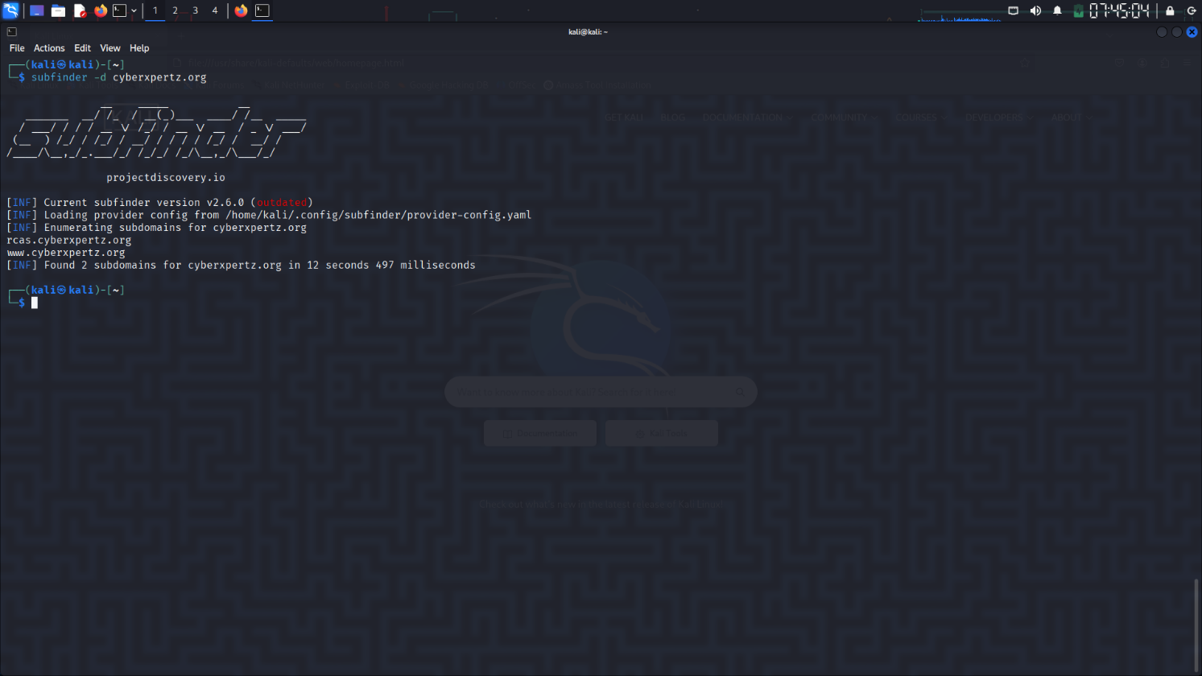
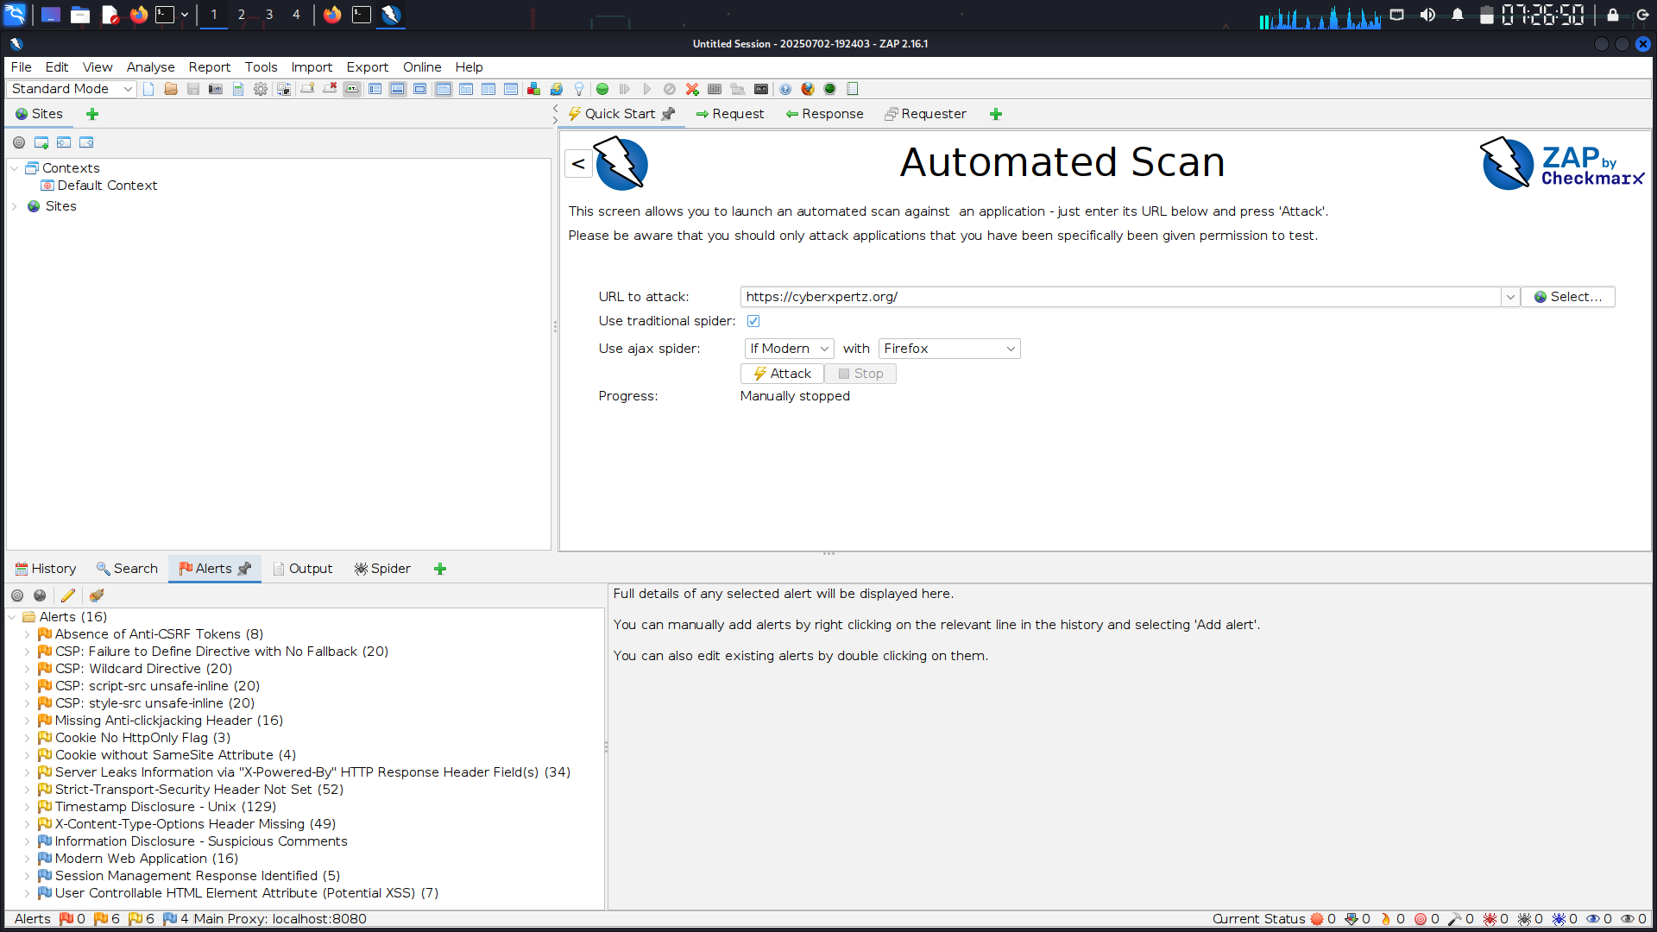
RESULTS AND KEY LEARNINGS

Slide 12
CHALLENGES
Some tools produced false positives, so manual validation was required.
Limited time to test all attack vectors in depth.
Needed to ensure all tests stayed within legal and ethical limits.
Managing and organizing multiple scan reports for clear reporting.
Configuring some tools for WordPress-specific scans took extra effort and troubleshooting.

Slide 13
CONCLUSION
This internship has been a valuable opportunity to apply my theoretical cybersecurity knowledge in a practical, real-world scenario.
By performing a complete VAPT of a WordPress site, I gained experience in using professional tools, identifying vulnerabilities in default themes and plugins, and recommending effective security fixes.
I learned how small misconfigurations or outdated components can become major entry points for attackers if ignored.
This project has strengthened my confidence to pursue a career in ethical hacking and web application security, and motivated me to keep improving my skills in this field.

Slide 14
THANK YOU

